Slide 1
Fintech: The next generation
Josh Huckin, Fintech Underwriter
Robb Roberts, Fintech Underwriter

Slide 2
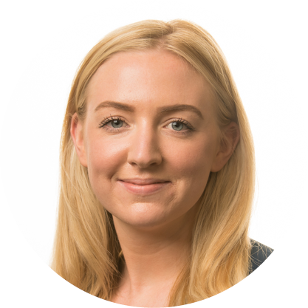
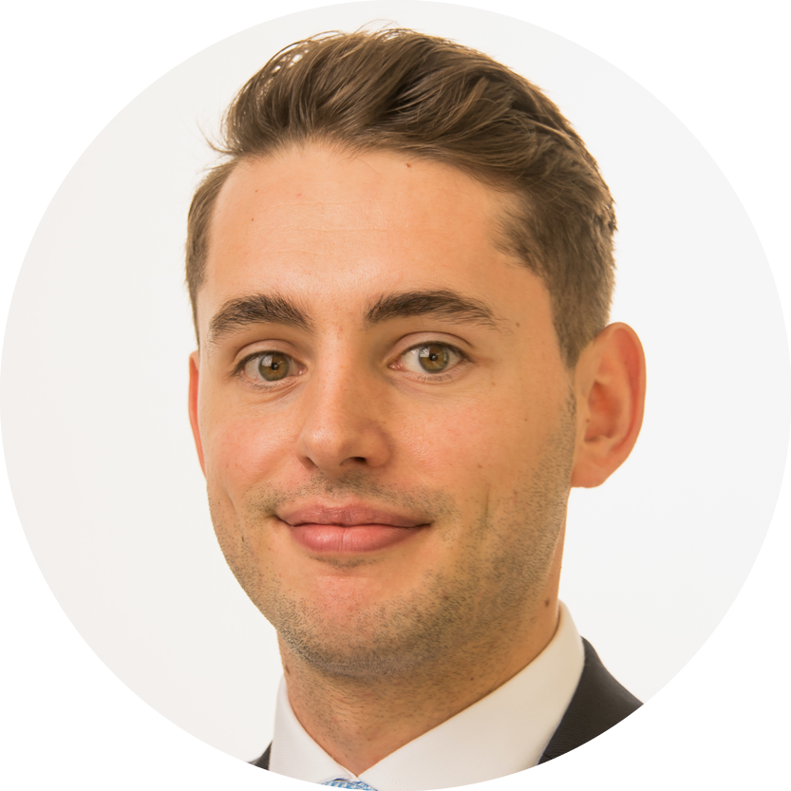




Fintech team
Hannah Durrant
Team Leader
Steve Bowers
Development Manager
Josh Huckin
Underwriter
Robb Roberts
Underwriter
Dafydd O’Leary
Assistant Underwriter
Will Alston
Assistant Underwriter
Notes:
Dedicated Fintech team

Slide 3
Opportunity
Global fintech market is $340bn and estimated to grow to $1,152bn by 2032
Funding at high levels in 2023 - $55bn worldwide, $20bn in the US
Over 10,000 fintech companies in the US
Incoming CFPB open banking regulation

Slide 4
Coverage
Fintech professional liability
D&O
Cyber
Crime
Regulatory investigations
GL
Commercial contents & BI

Slide 5
Coverage enhancements
1
2
Professional liability
Cyber
3
4

Slide 6
Cyber enhancements
Business interruption
Additional extensions
First party business interruption
Dependent BI
BI claims prep costs
Cryptojacking & botnetting
Hardware and software replacement costs

Slide 7
Coverage Enhancements
1
2
Professional liability
Cyber
3
4
Crime

Slide 8
Crime enhancements
1.
Employee crime and third-party crime
2.
Theft of client funds
3.
Social Engineering

Slide 9
Coverage enhancements
1
2
Professional liability
Cyber
3
4
Crime
Pre-investigation costs

Slide 11
Capabilities
Primary or excess limits up to USD 5m
Average retentions at USD 25k
Revenues up to USD 100m
Premiums from USD 5k

Slide 12



FinTech Appetite
Risks we like
Risks we consider
Risks we ordinarily decline
Accounts receivable and factoring
B2B Lending and software
B2B Trading platforms and software
Banking as a Service
Crowdfunding
Digital & App-based Banking
Insurtech
Investment Platforms and software
Payment technology and money transfer
Credit referencing
Non-advised pensions & retirement saving
Aggregator platforms
Retail trading platforms
Cryptocurrency exchanges or custodians
Mortgage broking/lending
Short term consumer lending

Slide 13

The CFC fintech toolkit
Book a tailored training session
Product
Industry
Key exposures
Appetite
Marketing
Affiliations
Any other assistance you might need

Slide 14
Thank you
Josh Huckin & Robb Roberts
Fintech Underwriters
jhuckin@cfc.com
rroberts@cfc.com
fintech@cfc.com

